Slide 1
ACLED Coding Training 2017

Slide 2
How the Project Works
ACLED covers political violence in all African countries on a weekly basis, and in South and Southeast Asia on a monthly basis.
ACLED is now extending its coverage to Middle East countries.
All team members are allocated a sub-set of countries for which they are responsible.
All data is submitted every Sunday, covering the preceding Saturday – Saturday period.
Team members use a standard search term, a tailored list of sources, and a standard Excel template for coding.

Slide 3
How the Project Works: Timeline
Sunday –
ACLED research assistants upload country data files to shared drive.
Monday –
Files are cleaned, published and analysed by other team members.
Remember – Even if you are working alone, your work is part of a bigger project. If you cannot complete your allocated workload, you cannot submit your work late.

Slide 4
How the Project Works: Assessment
Team members are assessed on a range of performance indicators, including:
The timeliness and reliability of their work;
The quality of their data;
Their speed and efficiency (from calculation of data coded, countries allocated, and hours worked);
Their communication skills;
Their ability to work independently with limited supervision.

Slide 5
How the Project Works: Communication
All e-mails should be responded to within 24 hours.
All e-mails you receive should be acknowledged, even with simple:
“Will do” or “Noted” or “I’ll get back to you on Thursday with answer.”
Please always communicate any problems, concerns, issues with workload early to allow these to be addressed early and effectively.

Slide 6
How the Project Works: Communication
Always consult the codebook and FAQs before you send a question. The latter have been developed to address ~95% of questions team members have.
Questions about how to perform a certain function in Excel or other software can often be answered by referring to online tutorials and Microsoft resources, so please consult these first.
Send questions not answered in FAQs, codebook or elsewhere online on as you work – please do not leave these until the data deadline.

Slide 7
How the Project Works: Time Management
Team members’ efficiency is always higher when they work in fewer, longer time slots:
If you are working 10 hours per week, you will be more efficient if you work in 2 x 5 hour slots, than 5 x 2 hour ones.
Keep a log of the hours you have worked: you will need to include this information when you submit work.
If you are struggling to work within the timeframe allocated, keep a detailed record of which tasks / countries took how much time to help identify where you can improve efficiency.

Slide 8
Basics
Data collection involves three steps:
Searching for reports of political violence using an online database of news reports;
Coding details of that political violence into a standard Excel template using pre-determined criteria, codes;
Reviewing and cross-checking for consistency, including checking existing coded data, referring to existing actor lists and codebook for details on how to code particular events, groups.

Slide 9
Resources
Most resources can either be found at acleddata.com or on the ‘Shared Google Drive’
These include:
FAQs, Codebook, and various guides.
*Ask your Research Manager if you need access to the Shared drive.

Slide 10
Searching – Coding – Reviewing
Complete your database search first; then do a shorter supplemental search (target sources, sites)
Database: ACLED uses both Nexis and Factiva. Make sure your Research Manager sets you up with access in the beginning of your assignment.

Slide 11
Searching – Coding – Reviewing
Complete your database search first; then do a short supplemental search (target sources, sites)
Use the following search string (as listed in your source list) for database search:
COUNTRY (for example, Somalia) AND violence OR attack OR ambush* OR battl* OR clash* OR conflict OR raid* OR riot* OR demonstrat* OR protest* OR unrest OR kill* OR shoot* OR bomb* OR explosi* OR wound* OR injur* OR casualt* OR displace*

Slide 12
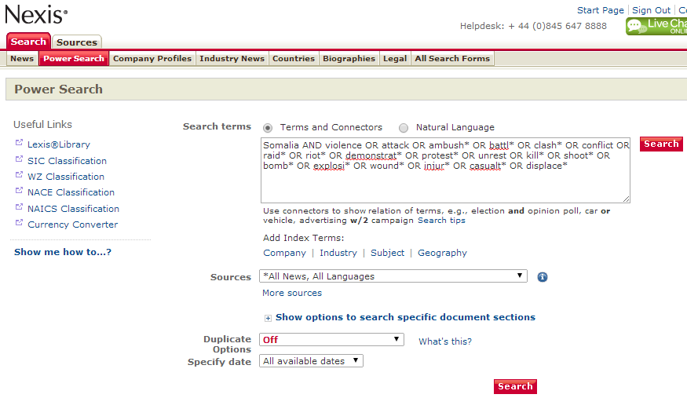
Searching – Coding – Reviewing

Slide 13
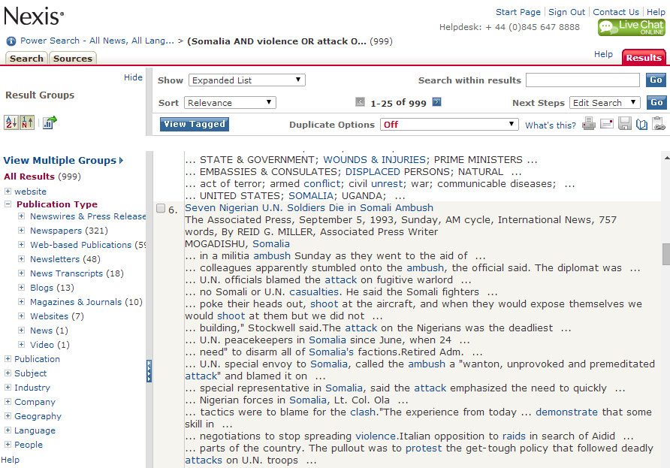
Searching – Coding – Reviewing

Slide 14
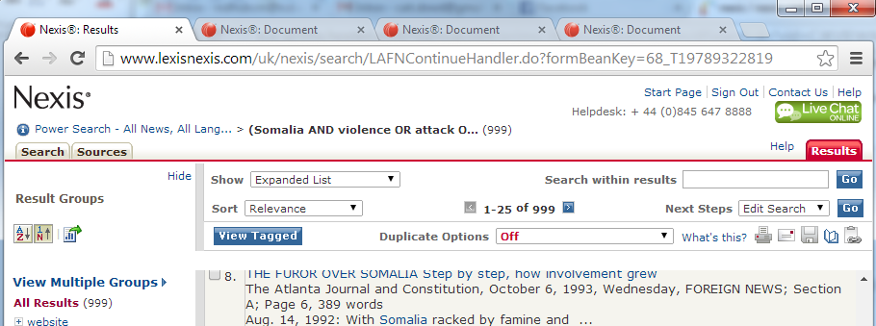
Searching – Coding – Reviewing
Read quickly:
Assess relevance of article from headlines;
Open new tabs for each article in database search.
Create your source material file first, and then code from this single Word document.

Slide 15
Searching – Coding – Reviewing
Once you have gathered relevant reports, you need to code these into the standard Excel template (a new file for each week);
Data is coded by:
Date;
Event type;
Actor and actor type;
Location; and
Fatalities.

Slide 16
Searching – Coding – Reviewing
Step-by-step on coding are listed in the FAQs
Please consult for each new event type, actor or type of coding, as you begin.
Almost all the content of the dataset is standardised, and must be coded exactly as it appears (cannot vary spelling, formatting, spacing or structure of the content), including:
Event date formats (UK date format);
Event type names (standard list, please do not vary);
Actor names (please choose an actor name from the actor to code; or follow steps in FAQs to propose a new addition); and
Geographic locations and coordinates (please choose one of the existing locations, or follow steps in FAQs to propose a new location).

Slide 17
Searching – Coding – Reviewing
Standardisation: important that coding does not vary in terms of spelling, formatting, spacing or structure, even in minute ways, as this will affect the quality and consistency of the data.
Event type names (standard list, please do not vary);
Battle-No change of territory
Battle – No change in territory
Battle- No change in territory
Actor names (choose an actor name from the actor file; or follow steps in FAQs to propose a new addition);
LRA: Lord’s Resistance Army
LRA – Lords Resistance Army
Lords Resistance Army (LRA)
Geographic locations and coordinates (choose an existing location from the publish file, or follow steps in FAQs to propose a new location);
Nairobi
Nairobi - Centre
Central Business District in Nairobi

Slide 18
Searching – Coding – Reviewing
Coding previous events
If you come across an event that was missed or wasn’t reported in a previous coding week, you can code it in your weekly submission.
e.g. If you are coding from 22nd-28th March 2015 and you find an event on 20th March that doesn’t appear in the ACLED dataset.
Check to confirm the event hasn’t already been coded.
Code the event as normal and highlight the whole row in blue

Slide 19
Searching – Coding – Reviewing
Coding previous events

Slide 20
Searching – Coding – Reviewing
Updated events
If you find additional information on an event previously coded in the ACLED dataset, you can propose amendments to that event.
Search for the event in the AllAfrica Running File (2015-)
Copy the whole row of data including the EVENT_ID (e.g. 326RTA)
Paste into current weekly Excel sheet and make the necessary changes
Highlight the whole cell in red
Make a note of the changes you made and why in your weekly cover mail.

Slide 21
Searching – Coding – Reviewing
Updated events

Slide 22
Searching – Coding – Reviewing
If unsure about the coding of an event (question about relevance, actor format or similar), flag the event for review in green and note in cover mail

Slide 23
Searching – Coding – Reviewing
Previous events not already coded highlight the whole row in blue.
Events that you have updated/changed highlight the whole row in red.
Events that you are unsure how to code/whether they should be coded highlight the whole row in green.
When coding new actors, highlight the cell in yellow.

Slide 24
Searching – Coding – Reviewing
When coding save a new file for every week (please do not add to previously submitted data).
Save your files in the file name format in the FAQs:
COUNTRY_YYYYMMDD to YYYYMMDD_INITIALS
Keep a record of your source material (a Word doc) and submit this alongside your data file.

Slide 25
Searching – Coding – Reviewing
Use the ‘Sort’ and ‘Filter’ functions to review your file for accuracy before submitting.
Check that all dates are formatted correctly;
Event types are spelled consistently;
Actors and actor types are consistent and correct;
Locations are correct; and
There are no blanks or missing data.
Always remember to ‘Select All’ in Excel if you are sorting or organising data: otherwise you will separate dates from other column content, etc.

Slide 26
Coding: Example 1
Please review and indicate how you would code:
Unknown terrorist elements attacked an Algerian military convoy on the road between El Ancer and El Milia. Two officers were killed and three wounded in the incident. No group has yet claimed responsibility.

Slide 27
Coding: Example 1
Event type | Actor 1 | Ally Actor 1 | Inter1 | Actor 2 | Ally Actor 2 | Inter2 | Interaction | Fatalities
Battle-No change of territory | Unidentified armed group (Algeria) | a | 3 | Military Forces of Algeria (1999-) |  | 1 | 13 | 2

Slide 28
Coding: Example 2
Please review and indicate how you would code:
About 600 residents of the Joe Slovo settlement in Cape Town clashed with police last night when they set fire to containers and barricaded the main road in protest at local evictions. Some demonstrators threw rocks at the police; one officer was injured. Elsewhere, peaceful protests against were held in Bothasig and Kleinbosch areas.

Slide 29
Coding: Example 2
Event Type | Actor 1 | Ally Actor 1 | Inter1 | Actor 2 | Ally Actor 2 | Inter2 | Interaction | Location
Riots/ Protests | Rioters (South Africa) |  | 5 | Police Forces of South Africa (1994-) |  | 1 | 15 | Joe Slovo
Riots/ Protests | Protesters (South Africa) |  | 6 |  |  | 0 | 60 | Bothasig
Riots/ Protests | Protesters (South Africa) |  | 6 |  |  | 0 | 60 | Kleinbosch

Slide 30
Coding: Example 3
Please review and indicate how you would code:
The South Sudanese SPLA was engaged in a fire fight with local ethnically Murle militants outskirts of the town of Wernyol in South Sudan. The Murle militia were resisting a programme of disarmament in the state which was launched in September.

Slide 31
Coding: Example 3
Event Type | Actor 1 | Ally Actor 1 | Inter1 | Actor 2 | Ally Actor 2 | Inter2 | Interaction
Battle-No change of territory | Military Forces of South Sudan (2011-) |  | 1 | Murle Ethnic Militia (South Sudan) |  | 4 | 14

Slide 32
Coding: Example 4
Please review and indicate how you would code:
The Kenyan military are being accused of human rights abuses in North-Eastern Province, after reports have emerged of officers rounding up and indiscriminately beating and torturing over a dozen young ethnically Somali men in custody last weekend.

Slide 33
Coding: Example 4
Event Type | Actor 1 | Ally Actor 1 | Inter1 | Actor 2 | Ally Actor 2 | Inter2 | Interaction
Violence against civilians | Military Forces of Kenya (2002-) |  | 1 | Civilians (Kenya) | Somali Ethnic Group (Kenya) | 7 | 17

Slide 34
Coding: Example 5
Please review and indicate how you would code:
The Ugandan military has reported a victory over a contingent of the Lord’s Resistance Army in north-eastern Democratic Republic of Congo. The military launched a campaign to capture the LRA’s commander last winter, and achieved a breakthrough on Tuesday when defeated a contingent in a firefight, and captured a dozen rebel troops.

Slide 35
Coding: Example 5
Event Type | Actor 1 | Ally Actor 1 | Inter1 | Actor 2 | Ally Actor 2 | Inter2 | Interaction
Battle-No change of territory | Military Forces of Uganda (1986-) |  | 8 | LRA: Lord’s Resistance Army |  | 2 | 28

