Slide 1
ACLED Training: Visual Analysis 2017

Slide 2
Basics
Tableau is a data visualisation and analysis programme which ACLED researchers use to order, analyse and interpret data. You will use Tableau Desktop (not the Server or Public versions).
The first step is to download the software:
Tableau Desktop is licensed software, but full-time students in accredited academic institutions can obtain a free copy for PCs by following the instructions at http://www.tableausoftware.com/academic/students.

Slide 3
Basics
Once the software is installed, open the programme in order to connect to your data by selecting File – Open and then selecting the Excel data file for analysis.
Tableau will prompt you to select the sheet in your file for analysis.
In most cases, your file will have the data on Sheet 1, so select this and then select OK and then select the Connect Live option and OK. This option allows you to edit the data in the file you are using in Excel while it is being analysed in case you need to make changes.

Slide 4
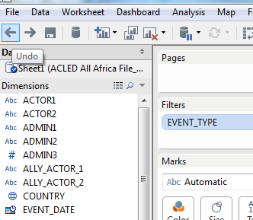
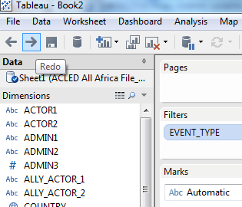
Basics
If you make an error or want to undo something, use the backwards and forwards navigation buttons in the left-hand of the toolbar to undo / redo or step backwards and forwards in your series of actions.

Slide 5
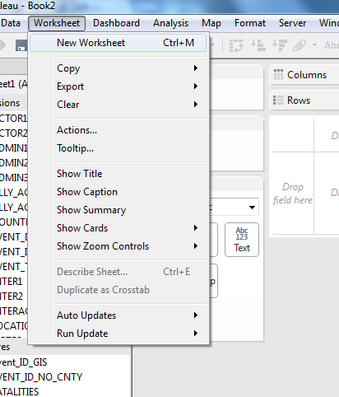
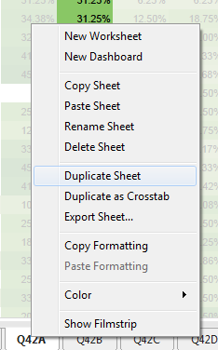
Basics
As in Excel, you can save more than one sheet of data and analysis in a single document.
To do this, simply select Worksheet – New Worksheet.
If you are making multiple graphs with only small changes, you can save yourself time recreating each sheet by selecting Duplicate Sheet. This creates a copy of the existing sheet, which you can then do small edits to (change Violence against civilians to Battles, for example), saving time.
To do this, right-click on the sheet, and select Duplicate Sheet.

Slide 6
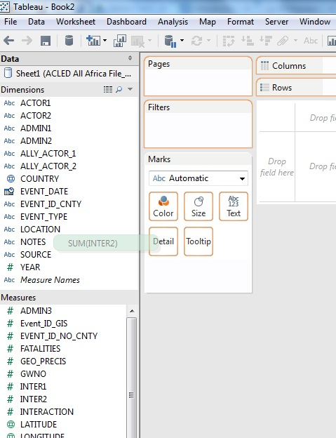
Variables
Once you have opened the data, your desktop will contain the column labels in the dimensions and measures windows.
Tableau assumes that the columns which contain numbers are interval variables (ie, that the interaction column values refer to 1, 2, 3, 4 units respectively).
This is not the case: many of the numeric variables in ACLED data are categorical variables (ie, interaction column values are codes for types of actors, but do not mean that a given actor has a value / cost / number of 2, 3, 4, etc.).

Slide 7
Variables
For this reason, the first step you have to take is to move the Inter1, Inter2 and Interaction, GeoPrecision and TimePrecision variables from the Measures window to the Attributes window.
Do this by selecting the variable, and simply dragging it to the ‘Dimensions’ window above.

Slide 8
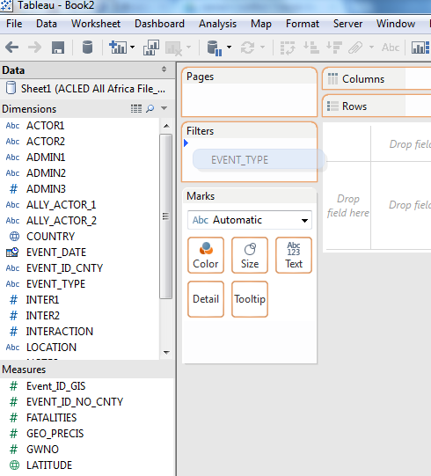
Filtering Data
The next step is to prepare your data for analysis. It is good practice to set up your data with the necessary filters first, before you begin analysis, to ensure you are always viewing the correct data.
The most important filter you will apply is to exclude non-violent activity from your analysis, as these events are not relevant to most of the visualisations, and are included primarily to facilitate users ‘reading’ the data, rather than statistically analysing them.

Slide 9
Filtering Data
To filter data, drag Event Type into the Filter window.
Then select the event types you want to exclude by ticking the events you want to exclude, and then selecting ‘Exclude’ in the bottom right-hand corner.

Slide 10
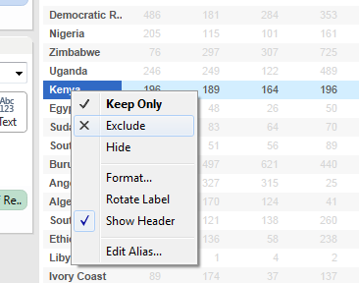
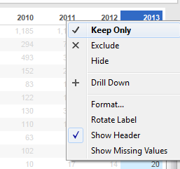
Filtering Data
You can also right-click on data in the actual data sheet to select data you want to keep or exclude. For example, if you only want to view 2013 data, simply highlight the 2013 column by right-clicking, and select Keep Only.
If you want to exclude certain data, highlight the data by right-clicking, and select Exclude:

Slide 11
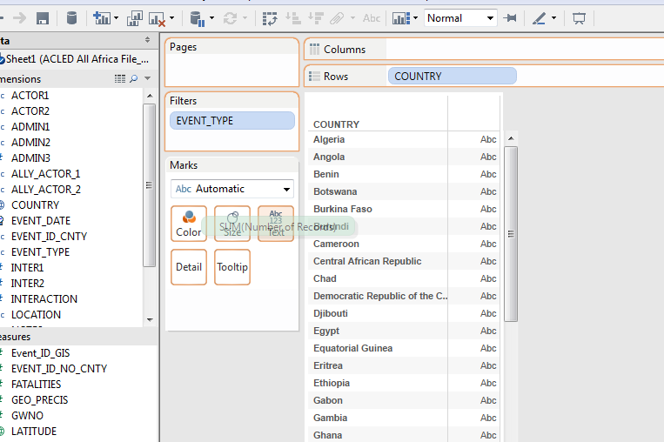
Analysing Data
To do very simple analysis, use Tableau to create and interpret basic tables. For example, to see how many conflict events occurred in each country, place the Country variable in the row section by dragging the country variable to the row area at the top of the screen.
Then drag the ‘Number of Records’ variable to the Text box.

Slide 12
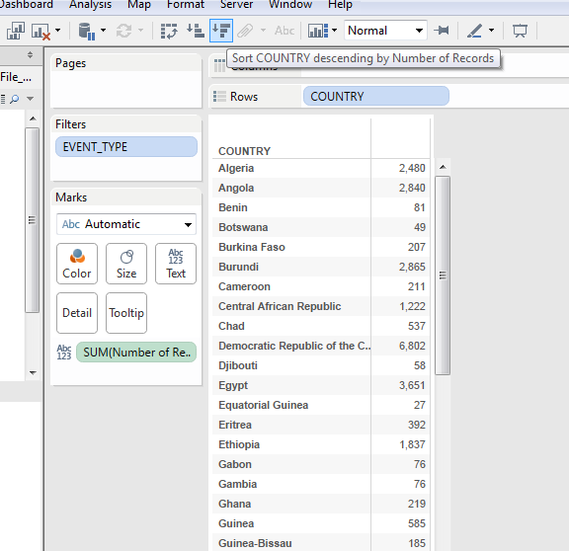
Analysing Data
This creates a simple table depicting the number of violent conflict events by country.
You can easily Sort this data by using the Sort button in the toolbar, ascending for lowest values to highest; and descending for highest values to lowest.

Slide 13
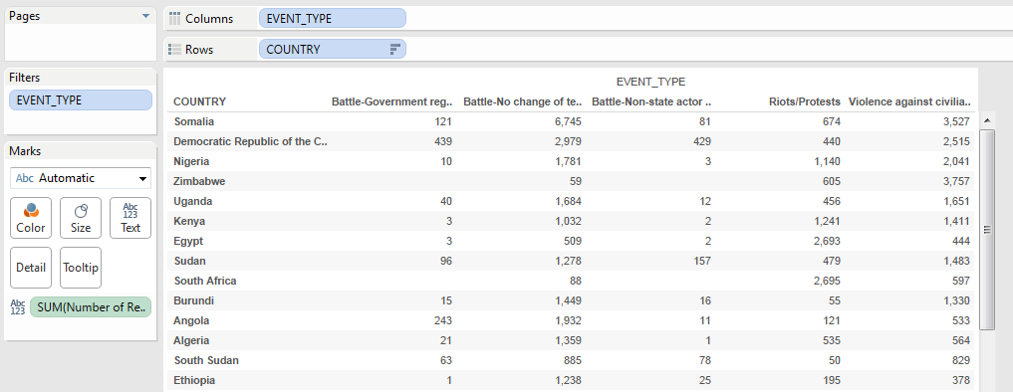
Adding More Variables
The steps above give you a very simple table, but you may wish to add more variables to get a more nuanced picture. For example, you can add Event Type to break down the different types of violent events. To do this, drag a variable either into the Column area, in which case it will show the event types across the top of the table:

Slide 14
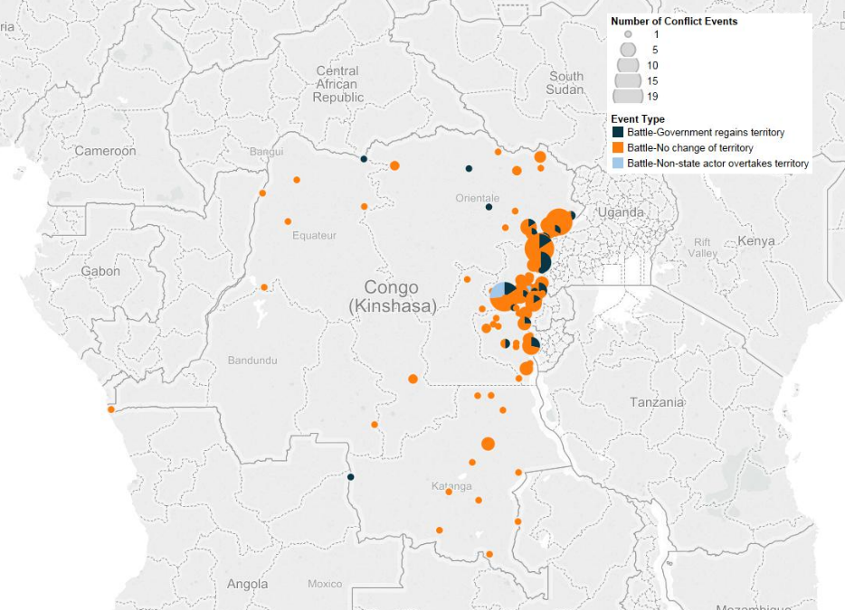
Event Type Variables
When analysing the event types, please remember the distinction between violent and non-violent events (see Guide to Producing Data Analysis and Written Reports)
Protests are not violent and therefore should not be analysed as political violence or armed conflict.
Any maps or visuals you create that analyse ‘conflict’ must only include armed organised violent events (e.g. battles) and not riots/protests (see map below). Please filter the event type variable in Tableau to exclude riots and protests.
You can create visuals with both protests and politically violent events but please remember to analyse them as separate forms of political contention in your written analysis.
E.g. Political violence peaked in June 2015 in Somalia, as Al-Shabaab increase their civilian-targeted violence. From July 2015, riots and protests decreased as government crackdowns made public assembly more dangerous.
Map 1: Number of Conflict Events by Location in DR-Congo, 2015.
Caption: Armed conflict was predominantly concentrated in North and South Kivu provinces, as non-territorial clashes were the dominant mode of conflict in 2015.
In this example, only battles are analysed as conflict events.

Slide 15
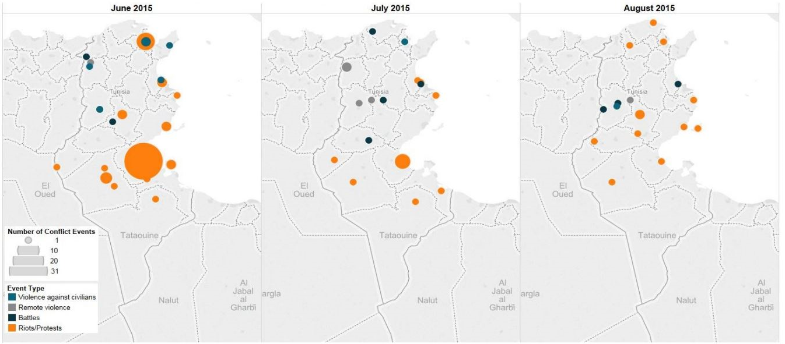
Incorrect Analysis of Event Types
Figure 1: Number of Conflict Events by Province in Tunisia, from June 2015 – August 2015.
Caption: The number of conflict events in Tunisia continued to decrease and overall conflict remained below average levels. In August, ACLED recorded 18 discrete conflict events, the lowest level since November 2014 when, however, the number of fatalities was higher (11, against the 6 recorded in the past month). This decline follows a spike in political violence in the first months of 2015, similar to that Tunisia which witnessed during the 2011 revolts
In this example, riots and protests have been incorrectly included in an analysis of conflict events

Slide 16
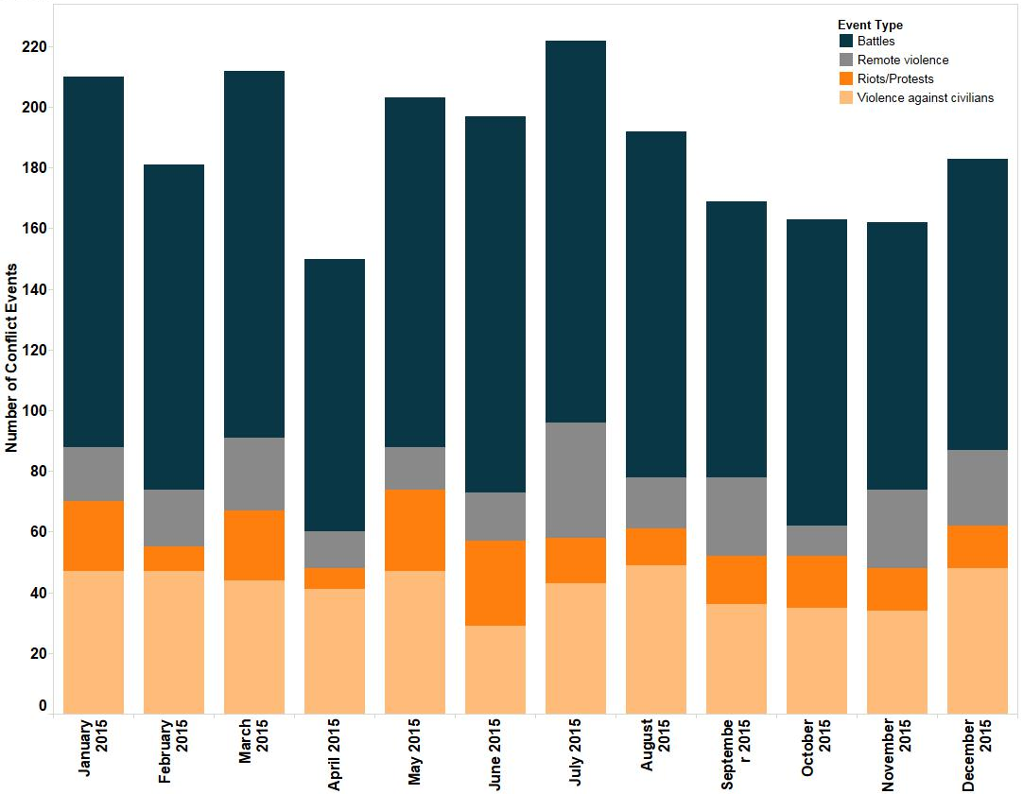
Correct Analysis of Event Types
Figure 2: Number of Political violence and protest events in Somalia, from January – December 2015.
Caption: Political violence peaked in June 2015 in Somalia, as violence decreased in the subsequent 6 months bringing the average to
170 incidences of political violence per month throughout 2015. From July 2015, riots and protests also decreased as government crackdowns
made public assembly more dangerous.
In this example, political violence and protest are visualised and analysed correctly in the written analysis.

Slide 17
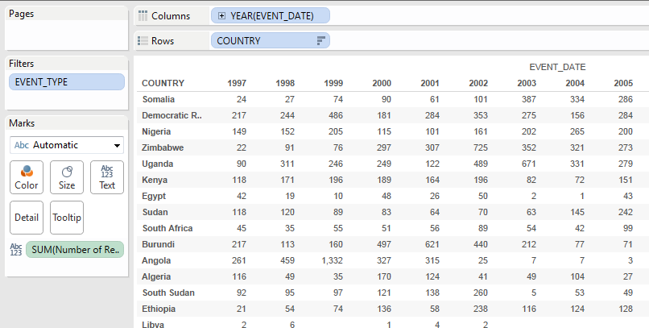
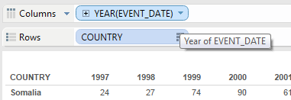
Dates
Another important variable is the Event_Date variable, which will allow you to view data by day, week, month or year. Simply dragging Event_Date into the column area will show events by year as a default.
You can break this down into quarter (three month periods), months, weeks or days.

Slide 18
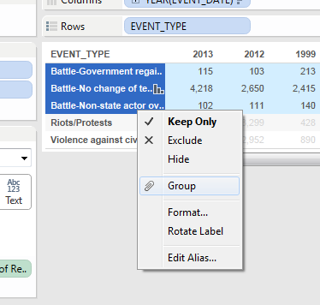
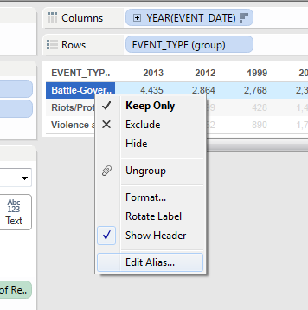
Grouping Data
Grouping data allows you to combine multiple units (such as multiple countries, years, or event types) under a single group. For example, you might want to analyse East vs. West African countries, and combine all countries in those regions. More often, you will probably want to combine different Battle types under a single Battle category, to make your analysis simpler.

Slide 19
Grouping Data
To do this, select the categories you want to combine and highlight them, right-click, and select Group:
You can then rename the group (for example, as Battles – Combined or West Africa or Democracies) by right-clicking on the name and typing in a new name.

Slide 20
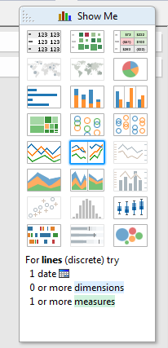
Graphics
Tableau is very useful for sorting and analysing data, but it is mostly used to visualise it. To create graphics, select the Show Me tab in the right-hand side of the screen:
Pick a chart type from the options available:

Slide 21
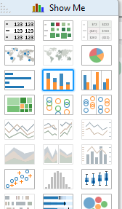
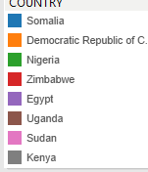
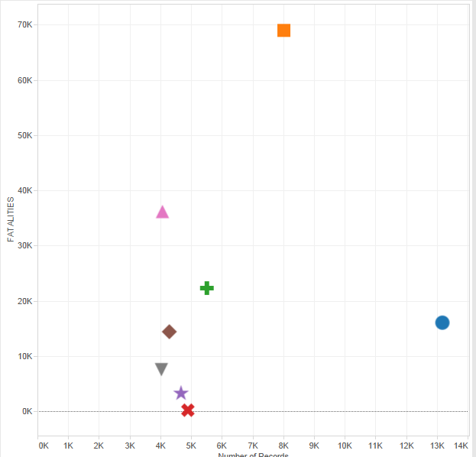
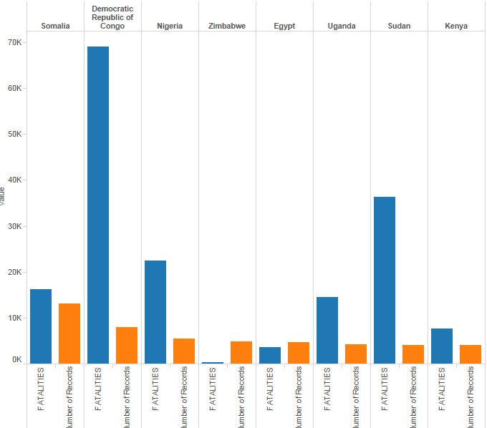
Graphics
Experiment – different charts show different types of information and are more or less suited to displaying different dynamics.

Slide 22
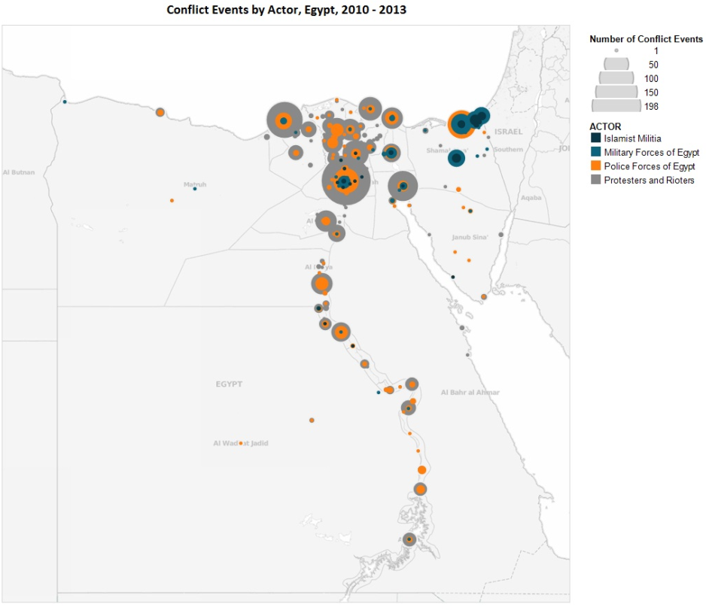
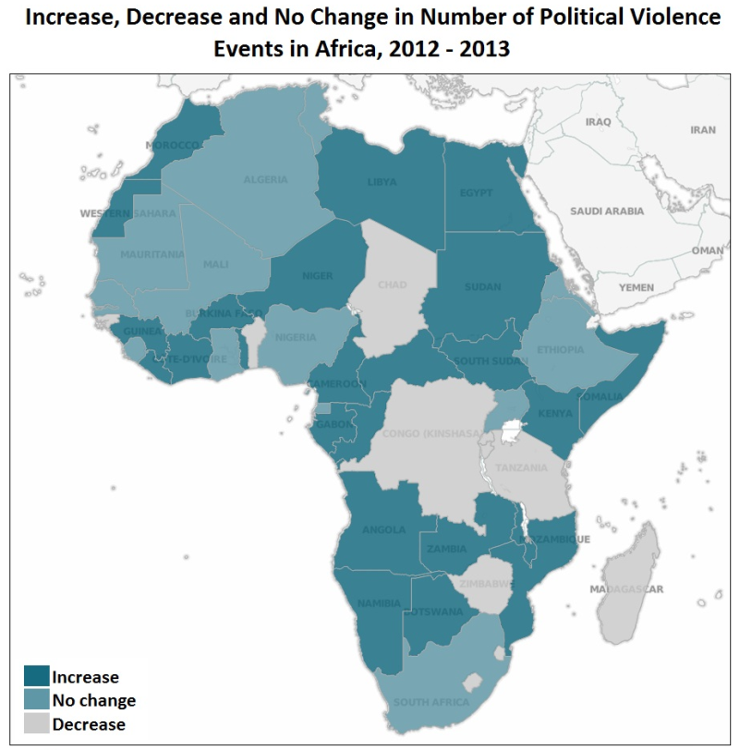
Maps
There are several types of maps:

Slide 23
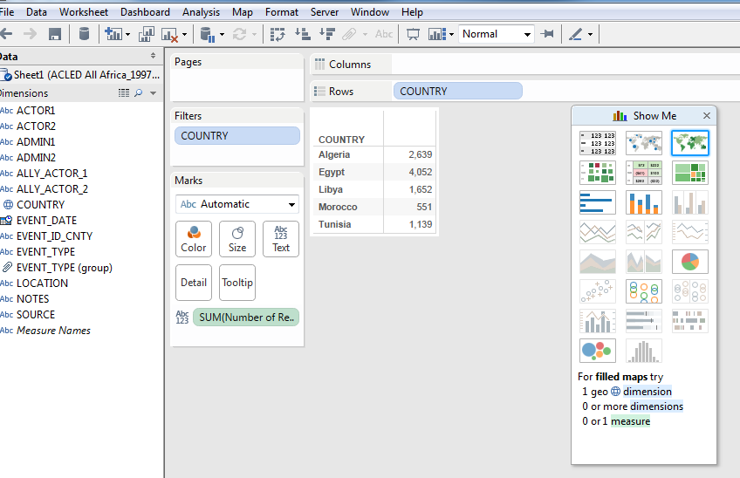
Maps
The first is a country-based map, which highlights the overall country. To do this, simply drag the Number of Records (in the files I have sent you, I have renamed this ‘Number of Conflict Events’ for clarity) into the Text / table section:

Slide 24
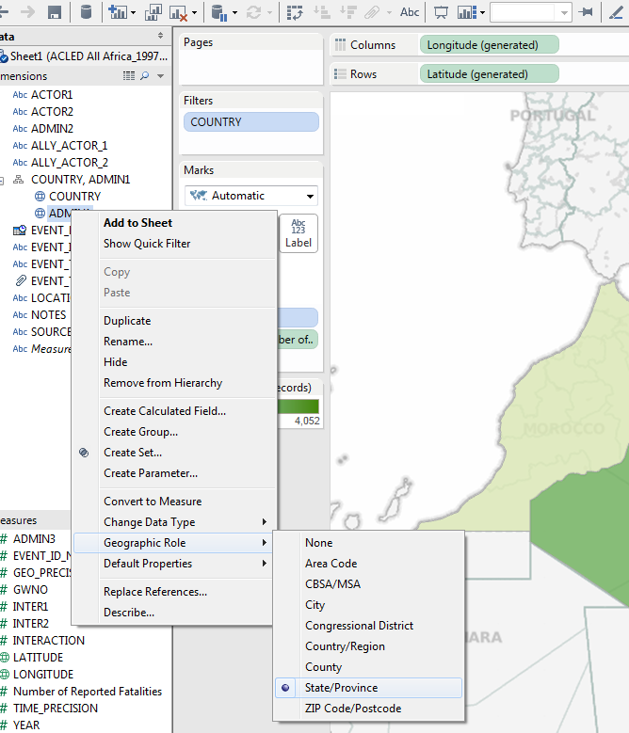
Maps
The second option is a sub-national map by country. To do this, you have to identify the variable ADMIN1 as a state, so Tableau understands this is a geographic category. For this, drag the ADMIN1 category under the Country variable.
Then right-click on the ADMIN1 category – Geographic Role – then select State/Province:

Slide 25
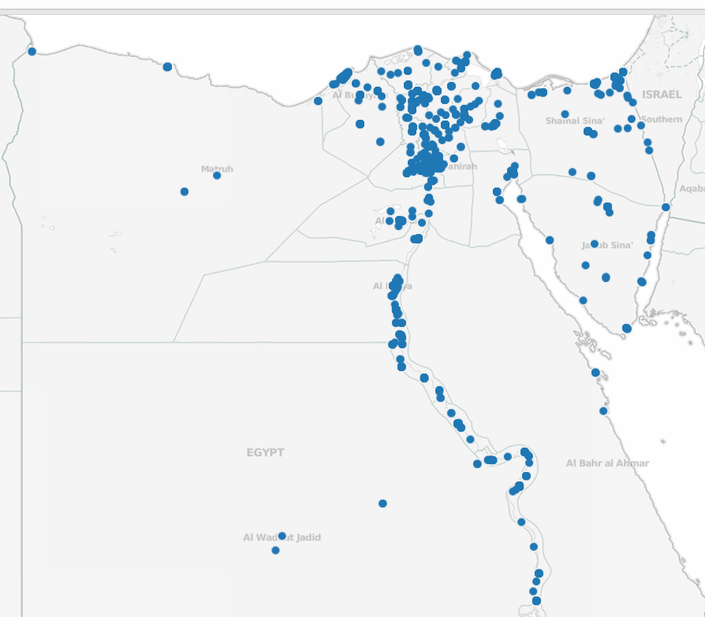
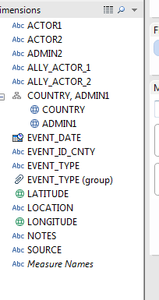
Maps
The third option is a sub-national location map by country. This represents every individual event by its coordinates.
To do this, you need to make sure your Latitude and Longitude variables are in the ‘Dimensions’ – not ‘Measures’ – window.

Slide 26
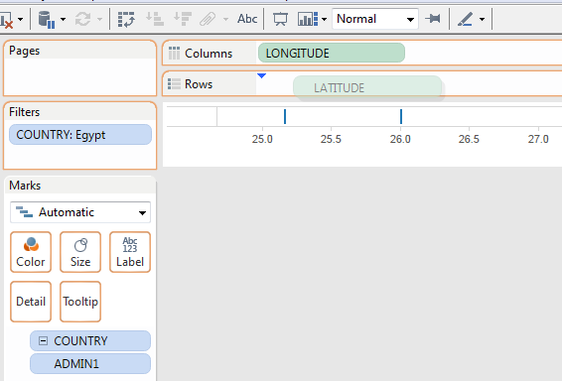
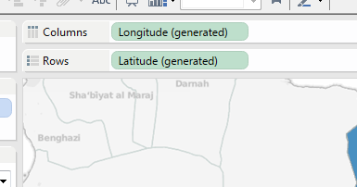
Maps
Make sure that the Longitude and Latitude variables are the ones you have dragged over from the Dimensions window, and not the ones that Tableau creates automatically - you can tell this when the variable says Longitude (Generated). There should be no (Generated) next to the variables:

Slide 27
Practice
Please take 10 minutes to create a visual that depicts violence in DRC using the data file on the ACLED V4 data page.
You can create a timeline, a map, a pie chart or any other variation you like.
Then please present to one another and discuss your graphic, any challenges, any steps you need clarification on.

Slide 28
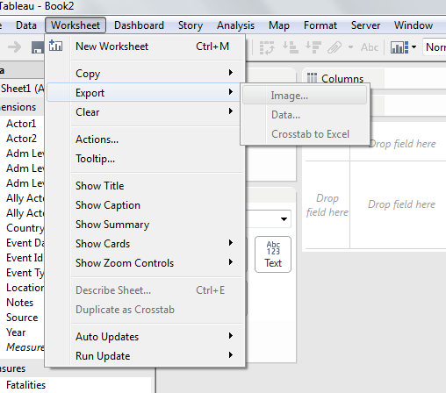
Exporting your Image
To use the images you have created, you have to export them from Tableau. To do so:
Go to Worksheet – Export – Image

Slide 29
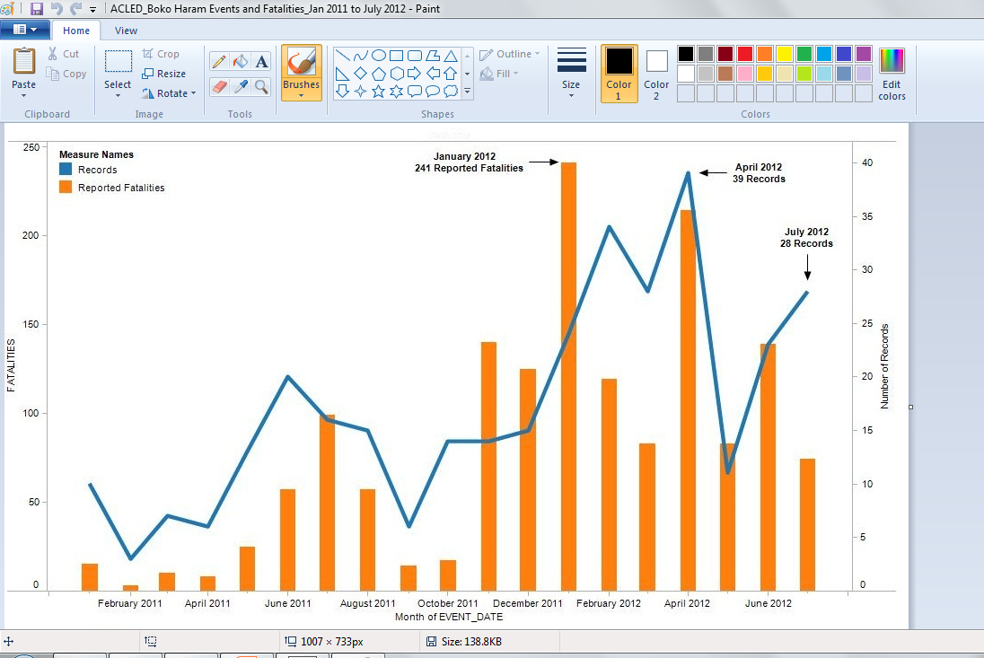
Exporting your Image
You can export as JPEG or EMF file, both of which can be edited on very basic image editing software (like Paint on Windows, Paintbrush on Mac or others);

